Slide 1
IBS Vietnam ISMS (Information Security Management System)
Version.1, 21st July 2014
Intelligence Business Solutions Vietnam

Slide 2
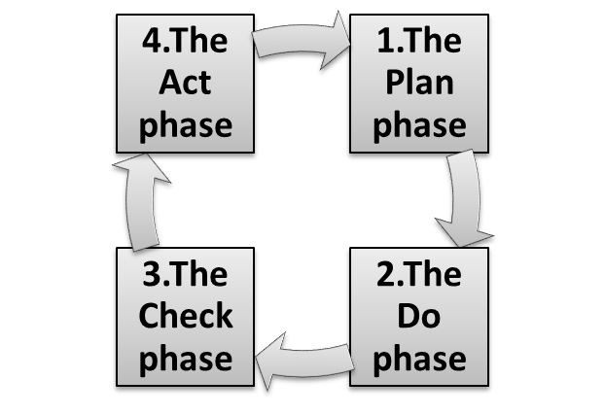
Do you know ISO27001?
ISO 27001 is a formal information security management system (ISMS) specification, which is the best – known standard that helps all types of organizations manage effectively undertakings regarding the management of information security risks; protecting personnel data; protection of confidential data; protection of information systems; management of operational risks in financial institution; etc.
ISO 27001 also recommends the methodology in order to manage information safety systems by following 4 phases below:
The cycle of 4 phases
Description
1. Making a basic plan for enterprise’s ISMS, establish goals for the system as well as choose the suitable security controls.
2. Carrying out everything that was planned at the previous phase
3. Monitoring all functions and check the result until meets the set objectives.
4. Adjusting and improving some heterogeneous points in the previous stage if any.
An effective ISMS is that follows this cycle of these four phases which is never ends, and all of activities must be applied orderly in order to keep the ISMS run effectively.

Slide 3
Why we have to follow ISMS?
Because, following ISMS give us trust. And also if we don’t follow ISMS, we might lose trust. ISMS is one of the best tools in the world to get a trust from the society.
Our purpose
Description
To keep a trusty recruitment agency
INTELLIGENCE group's primary business is Recruitment Service. Recruitment service deal with individual(=Candidate) data and enterprise(=Client) data. This data is the most strictly data in business. If we lost data or share data to outsider, INTELLIGENCE lost all trusty from society. Please follow ISMS even if we are in Vietnam, because we are the same team.
To keep a trusty IT service company
IT service domain also deal with individual(=Candidate) data and enterprise(=Client) data. In addition, IT engineer deal with bigger data rather than recruitment agency staff. And also we are specialist of information technology in INTELLIGENCE group. Don’t forget that if IBS Vietnam lost data or share data to outsider, we shutdown IBS Vietnam immediately for real.
To be a trusty business person
If someone show high performance but don’t follow ISMS, company don’t evaluate his performance and might dismiss him. As a business person, following ISMS is the most important things than showing high performance. Don’t forget that you have to be trusty business person before become good IT engineer. IBS Vietnam keep to hire only trusty business person.

Slide 4
What should we do now?
To realize our purpose of ISMS, we should to recognize 3 categories, 23 items of ISMS. Then we study and follow it. It’s very simple and easy. Please do it for our company and yourself.
Our purpose
of ISMS
To keep a trusty recruitment agency
To keep a trusty IT service company
To be a trusty business person
Described in
previous page
Our
purpose
of ISMS
Categories
ISMS Items
PC rules
Account/Password
Anti virus
Software install
Email
Internet access
Data export
Data erase
Clear screen
A
B
PC
rules
Office
rules
Describe from
next page
Office rules
White board
Paper
Locker
Mobile phone
Leaving desk
Leaving office
Last leaving office
Clear desk
C
General rules
General rules
ISMS manager
Incident report
Security area
Bring out data
Guest escort
Employee card
ISMS test
IBS Vietnam “ISMS Pyramid”

Slide 5
IBS Vietnam ISMS
A. PC rules
Do’s and Don'ts
ISMS Items
Basic descriptions
Do’s ○
Don’ts ×
Account/Password
Use your account and don’t give your account and password to others
Set complex password (characters, numbers, symbols) with length more than 8 characters
Change password once or more every three months.
Use others' account
Provide account or password to others
Anti virus
Use Anti-Virus software "Microsoft Security Essentials"
Set daily automatic scanning
Set automatic update of the definition file
Turn off daily automatic scanning
Turn off automatic update of the definition file
Software install
Install licensed software
Install necessary software for your job
Install licensed software
Install cracked software
Email
When send email including individual or sensitive information, please set password more than 4 characters
Use BCC when send mail to more than 2 customers
When mail is transmitted to two or more customers etc. , don't use TO/CC
Internet access
Access to websites related to your job and don’t access to websites that can transmit data to the externals
Access to websites related to your job
Access to websites that can transmit data to the externals. Ex: Gmail
Data export
External storage media such as an individual hard disk, USB thumb drives, and CD-R are not allowed to bring in our office
Ask ISMS manager to get permission when you need to export data
The setting of PC is changed to the setting that cannot be copied onto an external storage media
Data erase
Delete all data when provide laptop to new employees
Delete all data when receive new laptop
Give laptop with data to other employees
Clear screen
Set password for the screen saver (within 10 minutes)
Put normal information on sticky note or desktop of PC
Put important information on desktop of PC

Slide 6
IBS Vietnam ISMS
B. Office rules
Do’s and Don'ts
ISMS Items
Basic descriptions
Do’s ○
Don’ts ×
White board
Clean the whiteboard after using
Clean the whiteboard after using
Go out with text on the whiteboard
Paper
The data paper is cut with the shredder.
Cleaner collects the cut out paper at the office
Give to Admin to cut out with the shredder
Throw data paper into recycle bin
Locker
When a staff enter AOC, one locker and key are provided.
IBSVN admin staff manage to give locker, key to staff and keep the spare key
when staff quit AOC offshore, the key is returned.
When the key is lost, tell it to admin instead of ISMS manager
Mobile phone
Don’t register customer’s phone in your hand phone
Don’t photograph document, screen PC
Ask ISMS manager to get permission when you need customer ‘s phone
Connect your hand phone with PC
Leaving desk
When you leave seat for ten minutes or more, put the document in a personal locker and lock your PC
Lock you laptop when leaving seat for ten minutes or more
Put documents on desk when leaving seat for ten minutes or more
Leaving office
Don't place documents on desk, keep documents in personal locker.
Turn off your PC and keep it in personal locker.
Lock your personal locker
Place documents, PC, key on your desk
Last leaving office
Check all PC and documents in AOC offshore room are in the locker.
Close all windows and doors
Turned off all lights
Go out and forget to check lights, windows, doors, PCs
Clear desk
Don't put important information with the tagged paper and the scrapped paper on desk.
Manage things on your desk neatly
Put the name tag on the desk

Slide 7
IBS Vietnam ISMS
C. General rules
Do’s and Don'ts
ISMS Items
Primary descriptions
Do’s ○
Don’ts ×
ISMS manager
ISMS manager is selected by general director every April.
If ISMS manager is not present, general manager become ISMS leader instead
Confirm ISMS manager
Know who is ISMS manager
Incident report
When security incident happen, report to ISMS manager ASAP.
You don’t have to conceal the incident, even if it’s your mistake. If you report ASAP, you don’t have to pay penalty
If something happens but you can’t judge whether it’s an incident or not, ask ISMS manager
When incident happen, tell to project team member instead of ISMS manager
Bring out data
Taking laptop out of office is prohibited.
Use laptop in our office
Taking laptop outside
21. Guest escort
Write down guest name to guest list at the reception
IBS Vietnam employee have to escort guest
Don’t tell password of the door
When unknown guest come, ask his name and confirm to manager or admin member
When guest come, open the door and don’t escort (ignore him)
Employee card
Admin provide employee card to new employees
Wear employee card in office
Put employee card on desk
ISMS test
Discuss about ISMS with colleagues twice a year (Jun/Dec) and unscheduled
Do ISMS test every half year (before evaluation interview)
Read this document frequently (monthly is better)
Read this document only just before test
Attention : This document is written in the most important things. If you want to know details, please ask to ISMS manager any time.

